Slide 1
Empowering Farmers at District Level through Social Accountability Tools to Improve Performance Contract „Imihigo“ in Rwandan Agriculture Projects - Implementation Progress
December 1, 2021
Notes:
Opening sentence: Thank you Rolande and Helene for setting the stage to this project. The title of the project is Empowering Farmers at District Level through Social Accountability Tools to Improve Performance Contract „Imihigo“ in Rwandan Agriculture Projects
Closing Sentence: To begin I will share the chronology of our presentation.

Slide 2
BBL Agenda
Introduction to the political economy of PCs (Performance Contracts)/Imihigo
Participatory planning in agricultural PCs: Lessons from Nyanza and Kayonza Districts
Citizen testimonies (recorded) from the 2 Districts
Discussion
Notes:
Opening Sentence: We will begin this talk with an introduction to the structure of the presentation
Closing Sentence: After we have heard testimonials from citizens on the ground, we will invite you to join us in a discussion around the emerging lessons. (Next Slide)

Slide 3
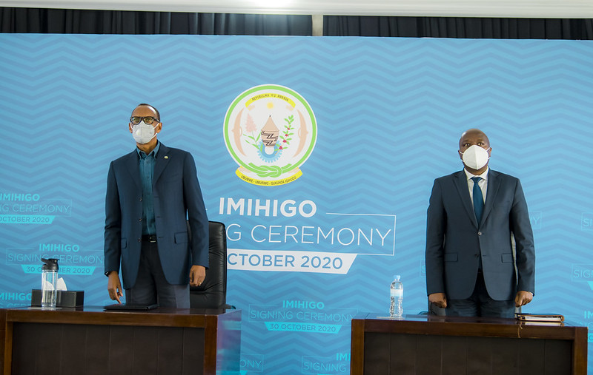
The political economy of performance contracts (PCs) „Imihigo“
PCs is an innovative and homegrown approaches that has strengthened service delivery, by strengthening competition for best results.
In Kinyarwanda “Imihigo ” means “the setting of goals”.
The progress Rwanda has registered stems from a combination of good leadership, development partner support, and innovative approaches to governance.
Notes:
Opening sentence: PCs are an innovative and homegrown approach that has strengthened service delivery, by creating competition for the best results. As you can see from this picture, it is overseen no less by the president Kagame himself. In Kinyarwanda, “Imihigo” means “the setting of goals.”
Closing sentence: The progress Rwanda has registered stems from a combination of good leadership, support from development partners, and innovative approaches to governance, like the use of Imihigo. Allow me to describe how the Imihigo is organized. (Next Slide)

Slide 4
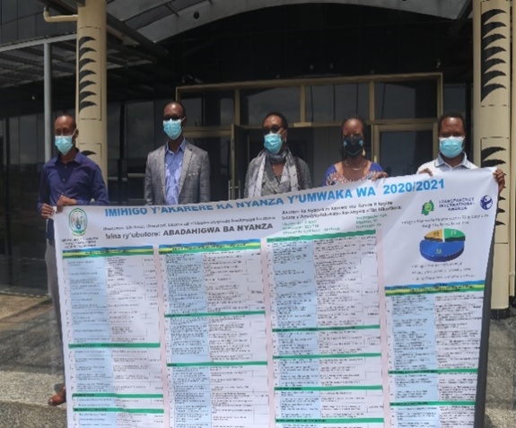
Imihigo & national planning system
Line ministries, public agencies and districts are required each year to sign formal public service agreements to deliver key specific output.
Process begins with grassroots consultations at village.
Village leaders submit citizens’ priorities to cell, for consolidation at sector.
Reporting is done quarterly. District organizes a public accountability day after each quarter to disseminate and to receive feedback.
Notes:
Closing sentence: Reporting is done quarterly. District organizes a public accountability day after each quarter to disseminate results and to receive feedback. The question though, is why did Rwanda organize Imihigo in the first place?

Slide 5
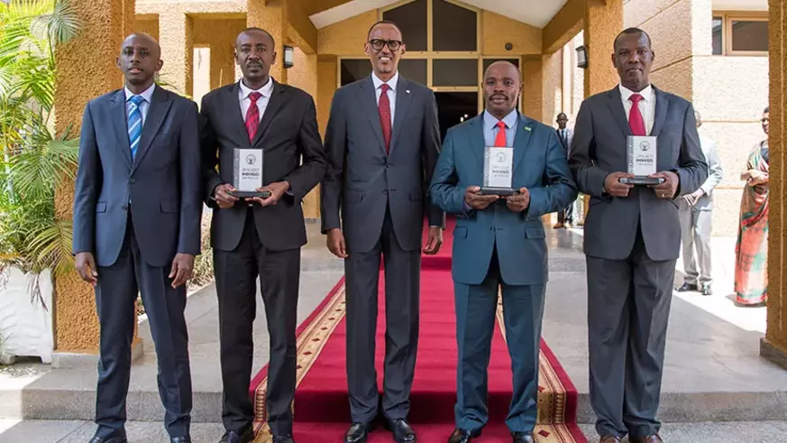
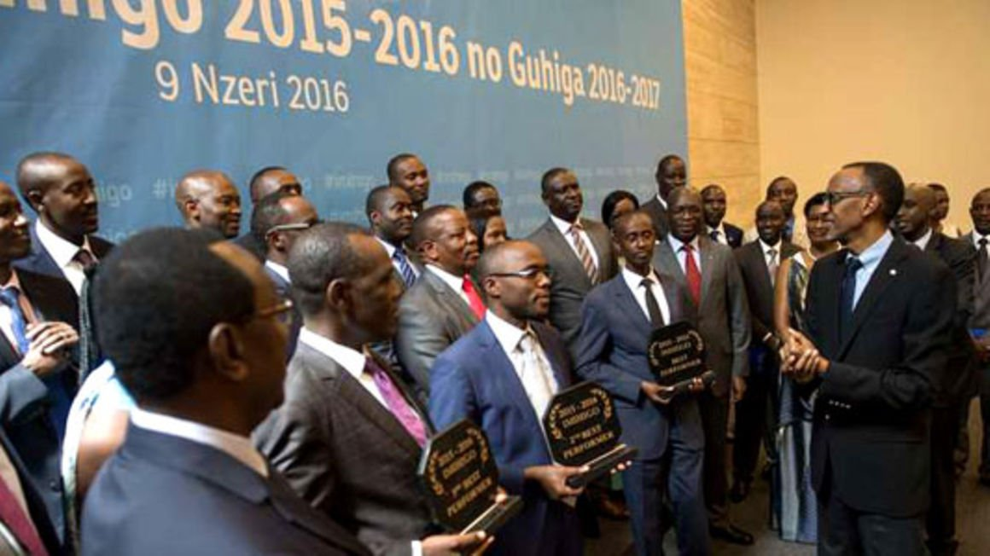
Why was Imihigo introduced?
As performance-based management tool to strengthen strategic planning and management and to improve service delivery in the Local Government system
To promote social accountability of leaders to citizens
Notes:
Five years into the plan of Vision 2020, progress had been painfully slow. More than half of the population still lived in poverty, only decreased by 2.2%, from 58.9% in 2000 to 56.7% in 2005
Closing sentence: To promote Leaders’ social accountability to citizens. Allow me to more specifically describe the aims of Imihigo

Slide 6
The Imihigo program had several ambitious aims, including to:
Speed up implementation of the local and national development agenda
Ensure stakeholder ownership of the development agenda
Promote accountability and transparency
Promote results-oriented performance
Encourage competitiveness
Ensure stakeholders’ participation and engagement in policy formulation and evaluation
Instill a culture of regular performance evaluation
Notes:
Closing sentence: In view of all these objectives, what, you may ask, what have been the outcomes of the Imihigo in other sectors?

Slide 7
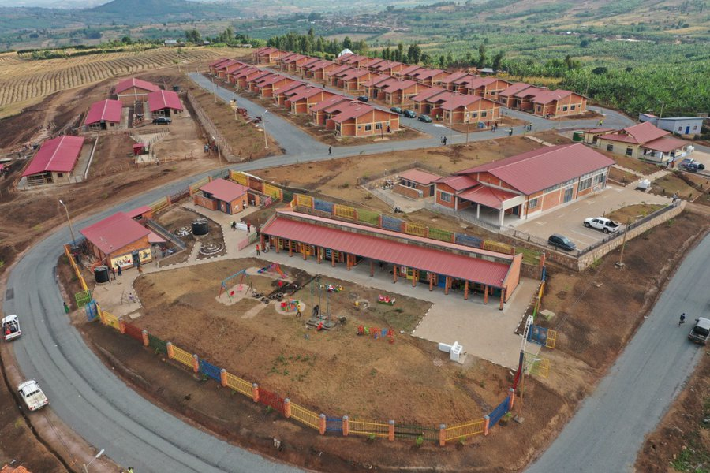
Key Outcomes of PCs
Enhanced creativity and strong focus on results introduced by PC at the district and sector level have translated into significant national development outcomes
The most notable examples include: the construction of rural roads, the expansion of access to clean water, complete eradication of grass thatched houses through bye-bye Nyakatisi national campaign
Health insurance schemes increased from 43.3 % to 87.3% of population between 2005 and 2019
The country’s GDP increased from US$3.3 billion in 2006 to US$8.6 billion in 2016
life expectancy increased from 55.3 years to 69 years over the same period.
Notes:
Health insurance schemes increased from 43.3% to 87.3% between 2005 and 2020 (NISR: EICV5, 2016/17; RHHS 2019/2020) and
life expectancy increased from 55.3 years to 69 years (World Bank WDI) over the same period (*) WDI data are for 2005 to 2019
Closing sentence: In addition, the poverty rate decreased from 56.7% in 2005 to 39.1% in 2013. In spite of these excellent results, there were challenges:

Slide 8
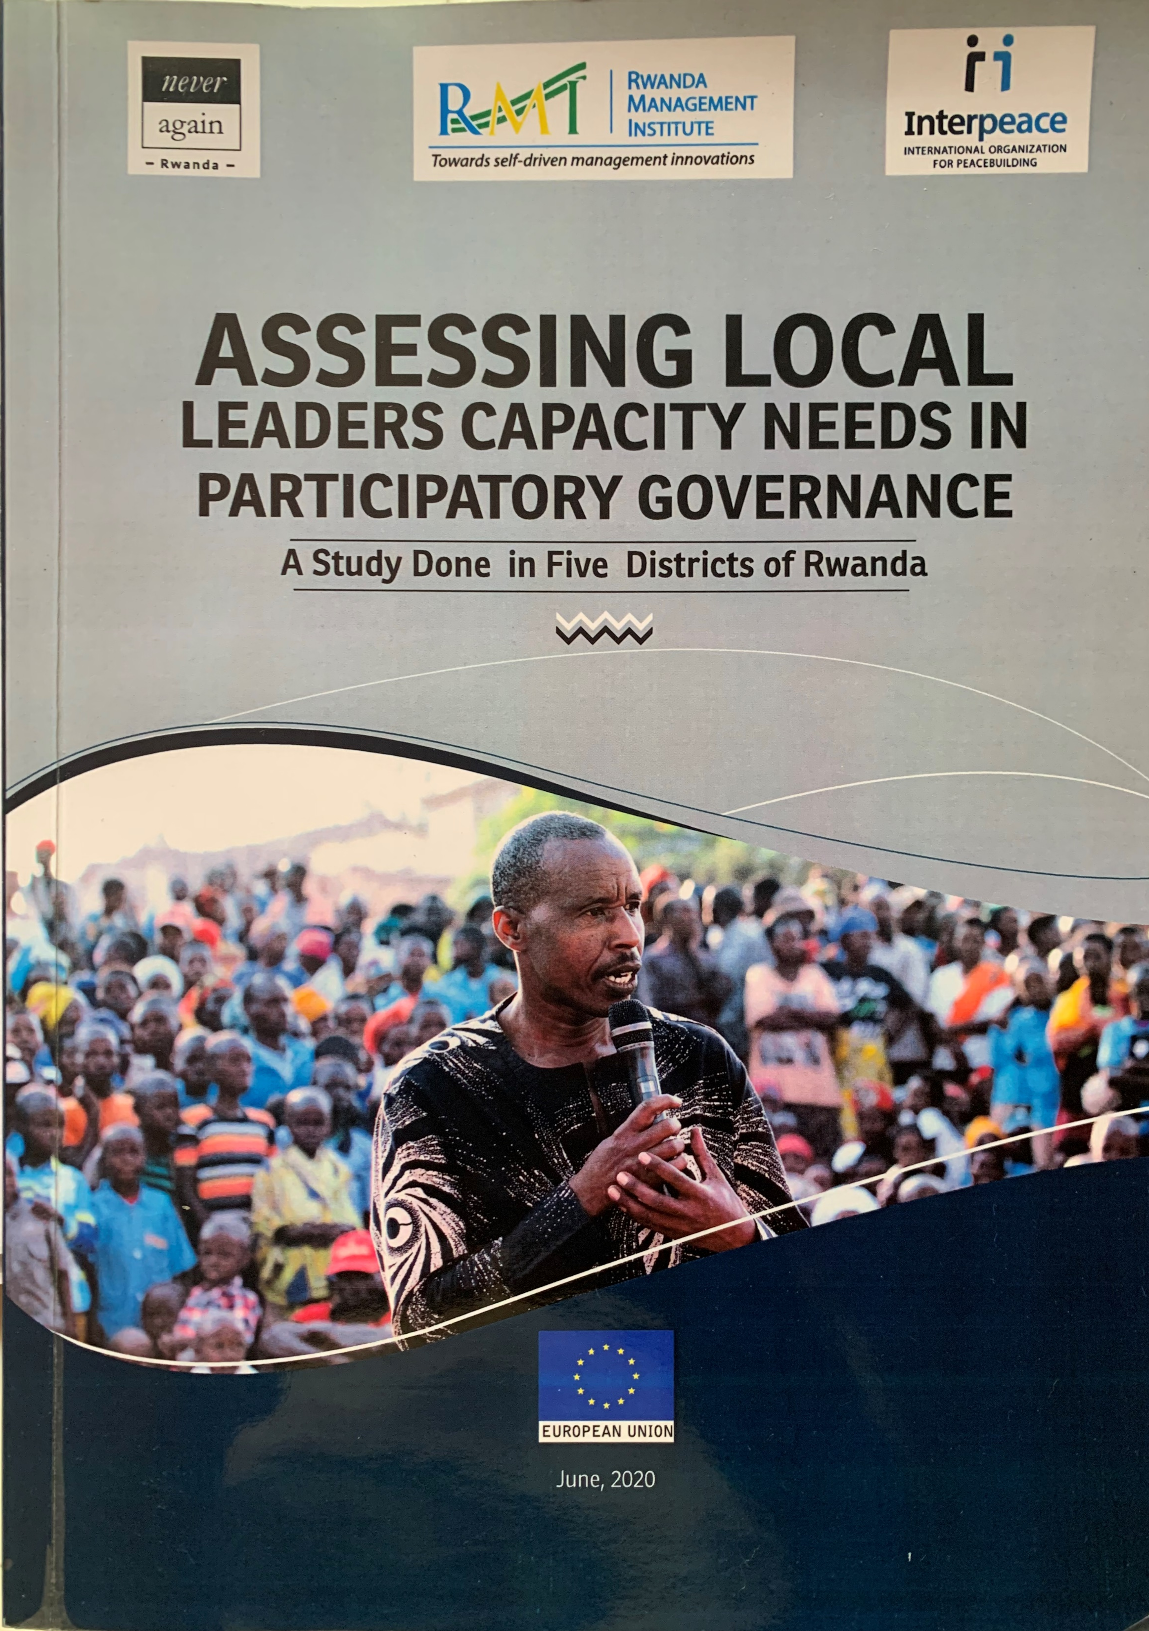
Challenges
There are some concerns that Imihigo did not necessarily ensure stakeholder participation.
Benjamin Chemouni, a fellow at the LSE, noted that “theoretically [the Imihigo-setting process] should be informed by the aggregation of the population’s wishes… however, this process barely takes place in reality” (Chemouni 2014).
“The central government wielded strong influence over the selection and implementation of district Imihigo, and local governments had little flexibility to implement policies that reflected local realities or the community’s wishes. As a result, the Imihigo system created top-down pressure for public officials to perform but did not necessarily make public officials more accountable to Rwandan citizens” (Hasselskog and Schierenbeck 2015).
Notes:
-A majority (84.4%) of local leaders have medium or lower levels of knowledge regarding participatory methods in planning (study done in 5 Districts)
Closing sentence: In view of these challenges the CMU with the support of the GPSA and in partnership with the Agriculture GP designed a project to strengthen how the Imihigo was working in the agriculture sector in Rwanda. I have the please to introduce the project to you.

Slide 9
Empowering farmers at District level through social accountability tools to improve performance contracts „Imihigo“ in Rwandan Agriculture projects funded by GPSA/WB implemented by TI-RW
The project objective is to address low citizen participation in policy planning, M&E of local and national agricultural development plans in Nyanza and Kayonza districts
Increase farmers’ ownership through effective participation in Imihigo process
Strengthen collaboration of CSO and Local officials at decentralized levels and document lessons learnt.
Apply TI-RW’s social accountability in Nyanza & Kayonza.
Collaboration with government institutions such as MINALOC, RGB, Nyanza, Kayonza Districts to improve results in participatory planning process.
Notes:
Closing sentence: Allow me to invite the project manager from the TI, Consolatrice to present the rationale and activities of the project.

Slide 10
What was the challenge in Nyanza & Kayonza?
The existing platforms do not engage farmers efficiently in the process of priority setting and M&E associated with Imihigo
Lack of ownership of the projects by farmers, poor local government planning, delayed implementation, and poor budget execution of agricultural activities

Slide 11
Project Objectives
The project addresses low citizen participation in policy planning, M&E of local and national agricultural development plans in Nyanza and Kayonza districts
To increase farmers’ ownership of agricultural development projects through their effective participation in imihigo process
To deepen cooperation between CSOs and government officials at district level; and integrate the lessons leant at all levels

Slide 12
Social Accountability Tools
Participatory Planning ( PP)
Citizen Report Card( CRC)
Social audit ( SA)
Integrity Pact Agreement ( IP)
Days of Participation tool kit. ( DoP)
Agricultural Imihigo week

Slide 13
Project Outcomes: 1. Increased farmers‘ ownership
104
Farmers’ priorities submitted in Nyanza
& Kayonza
53
Farmers’ priorities included in performance contracts in Nyanza & Kayonza
Notes:
31 drying facilities , timely delivery of agriculture, Improved and accessibility of some livestock services, MCC in Nyamirama & Cyabakamyi, Terraces projects, Rwinkwavu Marshland rehabilitation etc

Slide 14
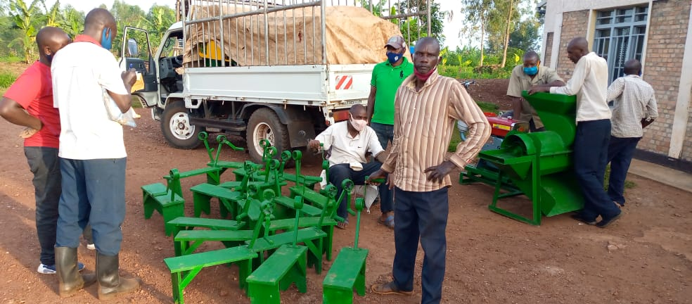
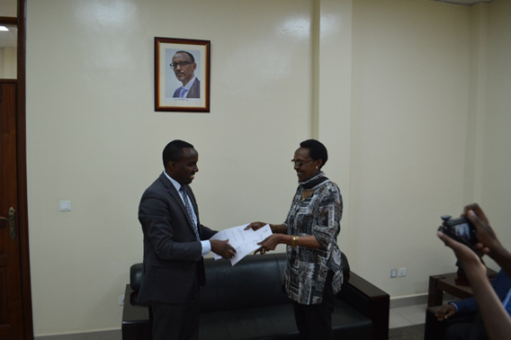
Project Outcomes: 2. Improved Cooperation of Government and CSOs
Provided a platform for district partners in Agriculture through District Agriculture Forum
Farmers Represented at the district level through District Farmers Network initiated
Rwanda Media Network on Social Accountability initiated
Working relationship improved through MoU

Slide 15
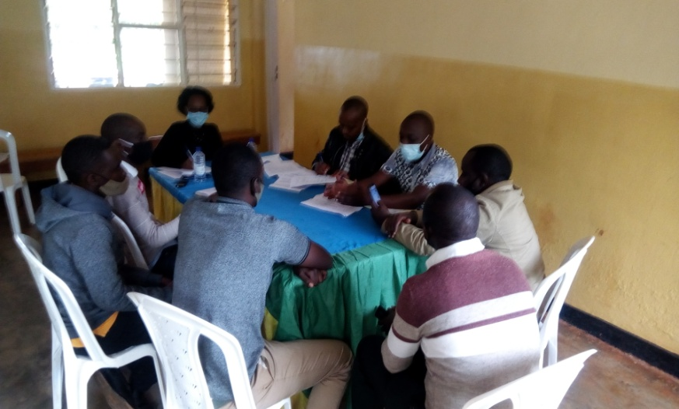
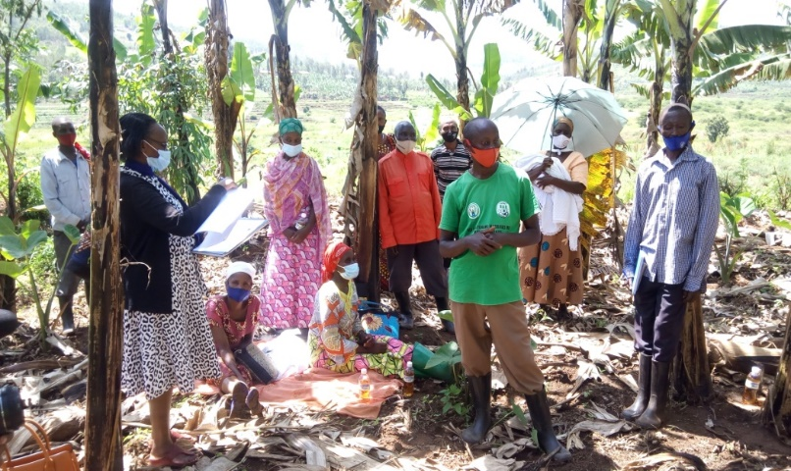
Project Outcomes: 3. Monitoring Imihigo with JADF
GPSA project district coordinator was appointed by JADF to evaluate Imihigo
Recommendations and advise provided to the district authority to inform the next planning phase

Slide 16
Farmers‘ satisfaction with their participation increased
Indicators | Baseline of the project (2017) | CRC1 | CRC2 | CRC3
 | % | % | % | %
Farmers satisfaction with their participation in the district Imihigo planning | 23 | 53 | 62.8 | 62.24
Farmers satisfaction with their participation in Evaluation | 20.8 | 49.2 | 62.02
Challenges :
no farmers' strong participation in setting prices
Farmers' return on their investments is low

Slide 17
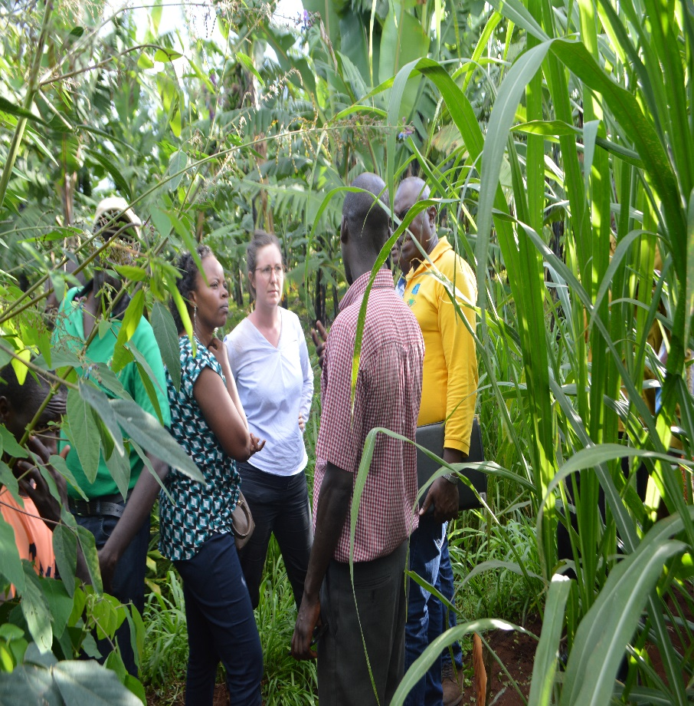
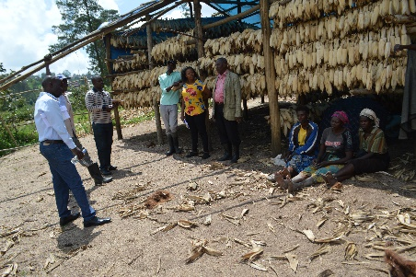
Lessons learnt
Effective citizen participation in agriculture can be a real ingredient of transformation in agriculture.
Notes:
This Project encouraged and advised us to work efficiently and effectively for achieving the national target through the performance contract IMIHIGO . Farmers under GPSA network embrace the idea and improved their working conditions . We have moved from subsistence farming to commercial farming. Together with our leaders we decide which crops to cultivate . No conflict over choosing crops anymore

Slide 18
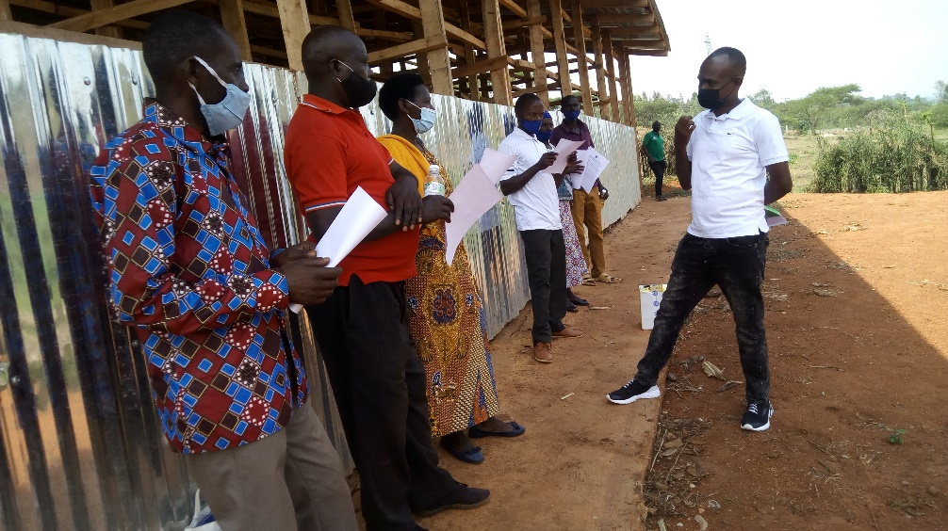
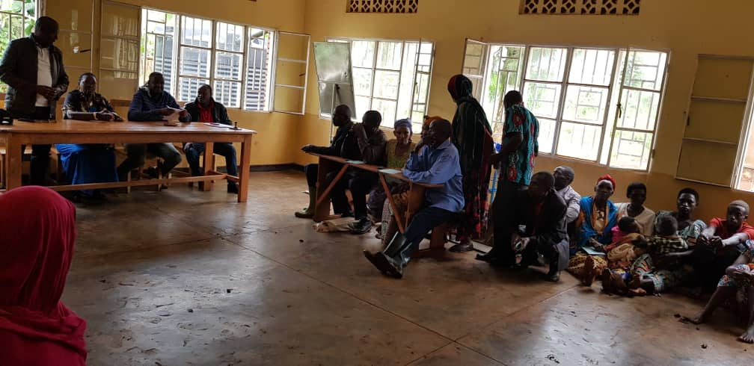
Lessons learnt, Cont.
When both citizens and leaders are empowered, citizen participation can become more real and more impactful
Farmers committee interventions recognized by local leaders and their mandate expanded
GPSA Farmers committees serve as liaisons between farmers and authorities
Farmers Councilors week lead by Farmers Committees

Slide 19
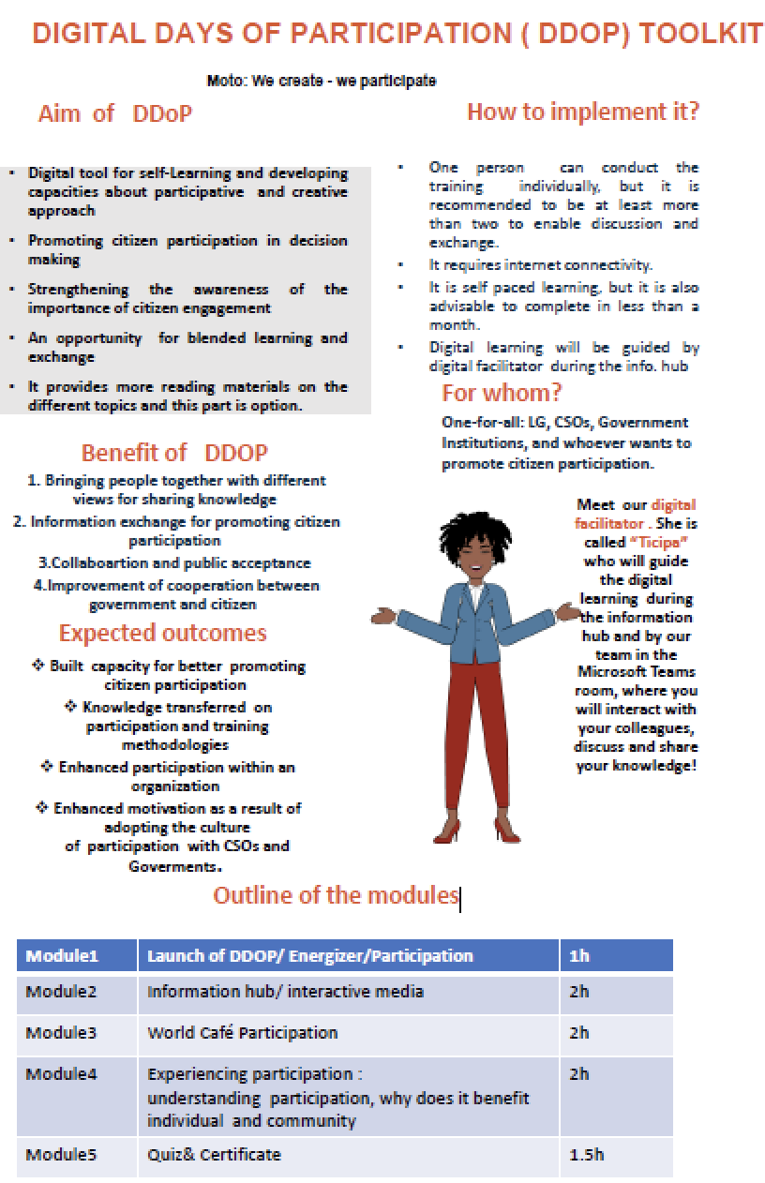
Lessons learnt, Cont.
Project Intervention changes to respond to COVID-19 emergency
Organized a joint community awareness campaign to raise awareness among farmers about COVID-19 and its prevention measures
Provided feedback through radio talks
Created WhatsApp group for farmers
Days of Participation toolkit (DoP) digitalized

Slide 20
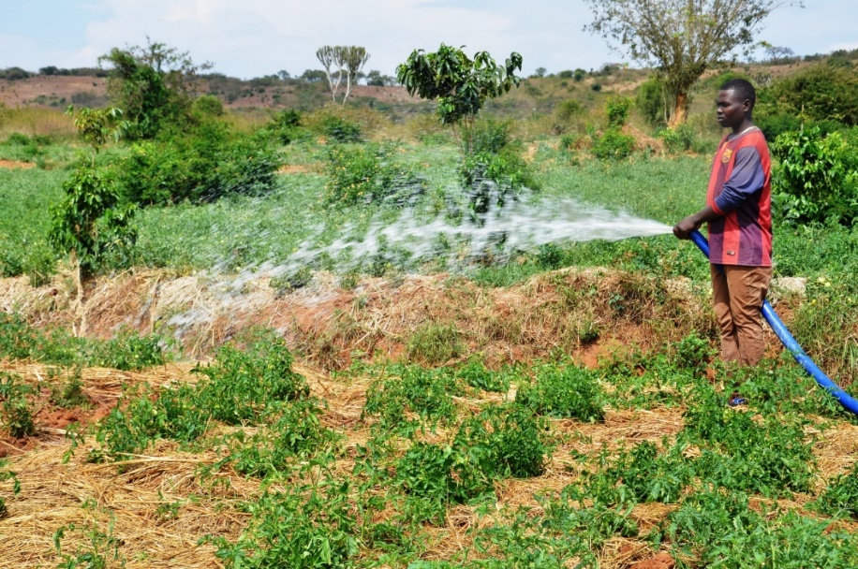
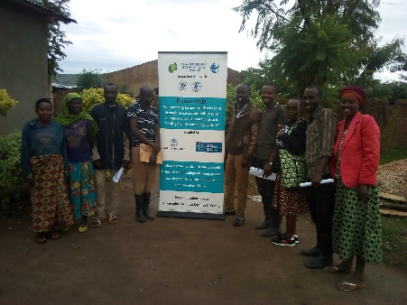
Lessons learnt, Cont.
Increasing meaningful participation in decision making process of agricultural project retains youth in agriculture
The farming activities were taught to be fit for aged people.
However, involving youth effectively in choosing the type of crops and introducing mechanization have encouraged us to participate in the farming of vegetable and fruits which is giving us good money in a short while.
Notes:
youth group from Rwinkavu Cooperative

Slide 21
Way Forward
Building on the initiated concepts & SA mechanisms to further enhance the project interventions on:
New methodology of farmers priorities identification
For more detail, click here
Institutionalizing the initiated SA
Increasing farmers participation in price setting and their bargaining power
Strengthening mentorship training
Scaling up SA to improve Performance contracts to new 3 districts (Rubavu, Burera, and Kamonyi) with funds from FCDO
Notes:
Farmers are empowered to use Social Accountability tools and with their initiatives there is hope that they will continue to channel their priorities through created mechanisms

Slide 22
THANK YOU
www.tirwanda.org
Email: info@tirwanda.org
Facebook: Transparency International Rwanda
Twitter: @TI_Rwanda

Slide 23
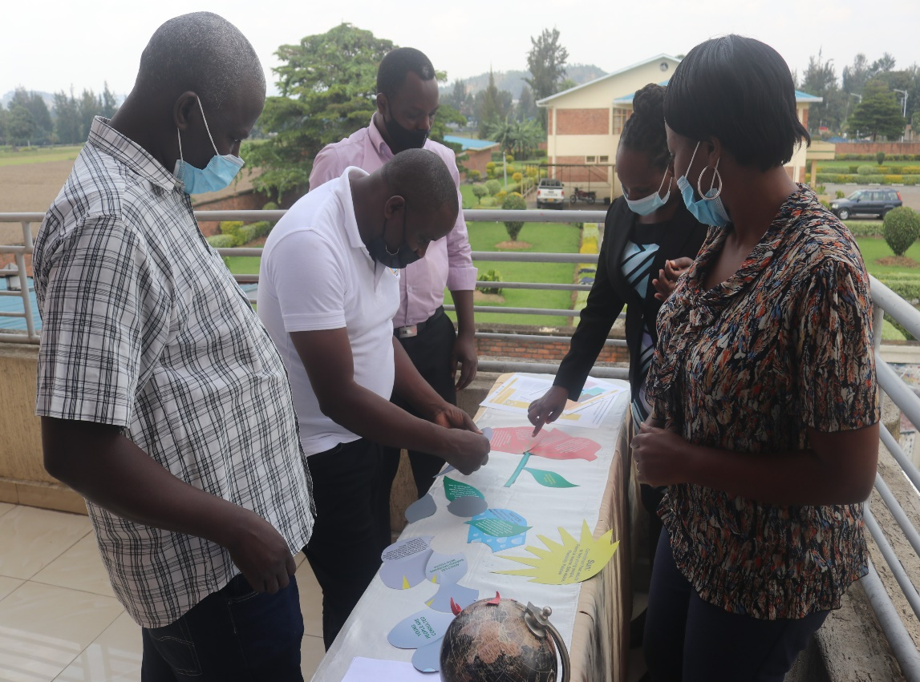
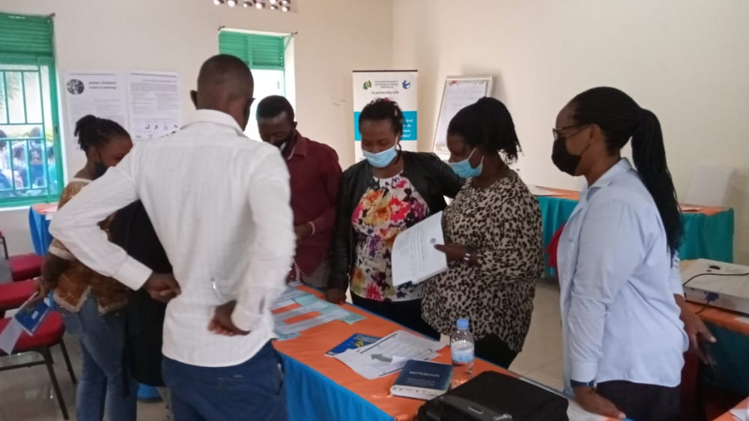
Days of Participation: “We create – we participate“

Slide 24
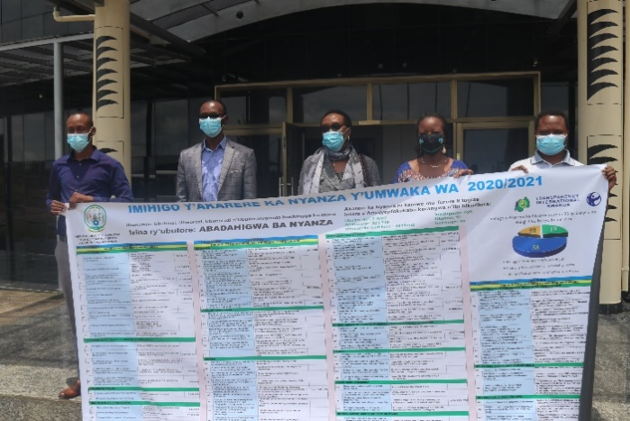
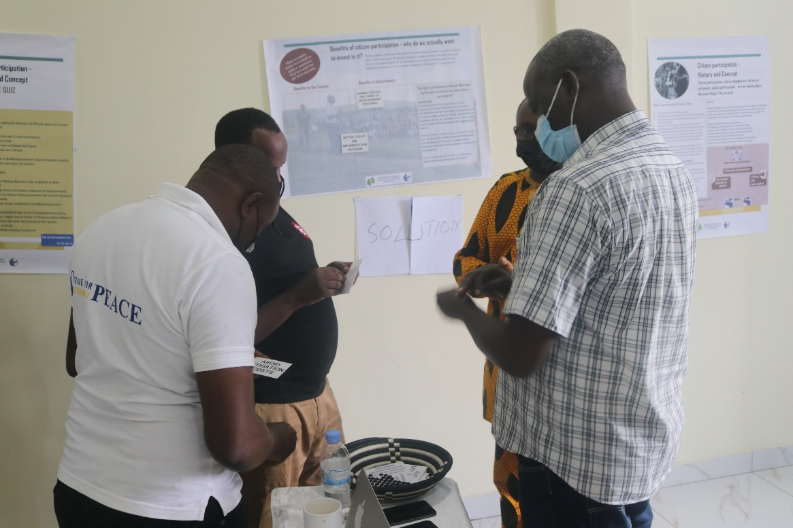
Project Outcomes: 3. When both ciitzens and leaders are empowered, citizen aprticipation can become more real and more impactful.
Photo : Imihigo dissemination to the village level
Photo: DoP with CSOs Executive Directors

